Slide 1
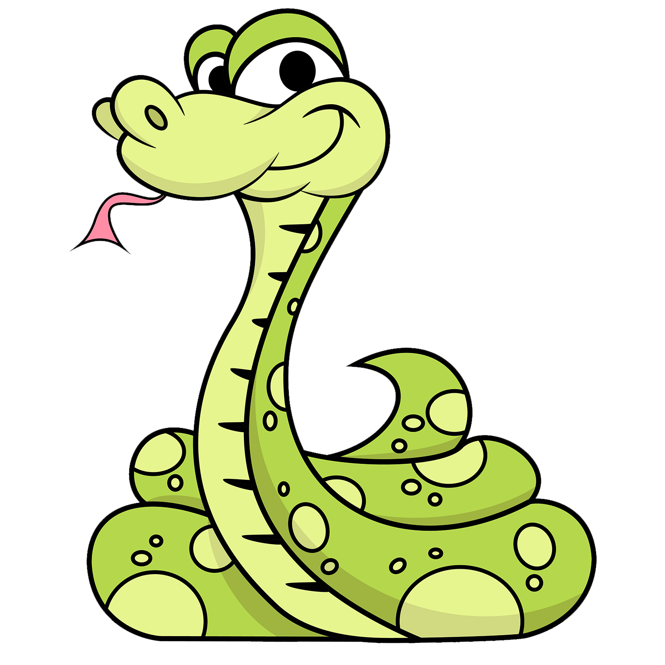
Snake AI
Developing a self-learning snake
game using Reinforcement Learning and pygame
Imen Selmi
GI2S3
Notes:
Hello everyone today we are going to talk about snake game with deep reinforcement learning .
I chose this application because i wanted to know how rienforcement learning works in real application .

Slide 2
Table of Contents
01
02
03
04
Common concept
Quick Intro to Game Development
Designing the gameplay
How it works ?
RL concepts
Agent,State,Reward,Policy,MDP
and few more
Code Logic
Events and control,Implementation
Notes:
First let met show you the content of this presentation :

Slide 3
01
Common concept

Slide 4
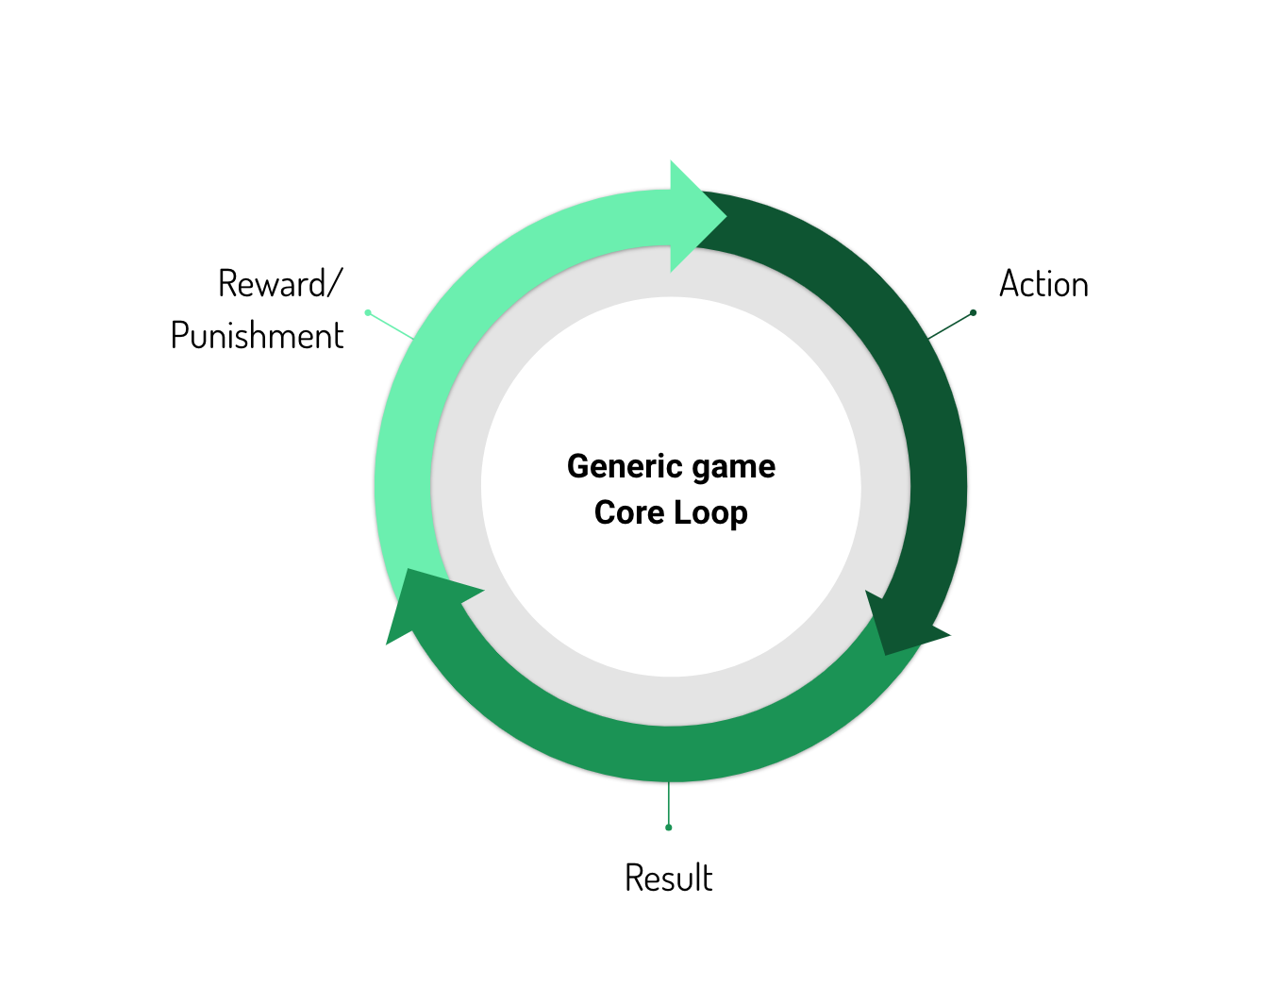
Game Development concepts
Coordinates : The screen is a 2D grid plane with (0,0) in the left.
Colors : RGB and alpha values.
Drawing : Plotting pixels surface object, blitting.
Rendering : Animator.
the game loop :
Notes:
When we want to make a game, we need to know what is the concept of this game .
So first we choose the :
i generated the loop game

Slide 5
02
Designing
the Gameplay

Slide 6
What we need ?
CPU
Pytorch
1
2
3
4
Python
VISUAL STUDIO
Notes:
I used in this application

Slide 7
Steps
1
8
Installing Pygame
Displaying the Score
2
7
Create the Screen
Increasing the Length of the Snake
3
Create the Snake
6
Adding the Food
4
5
Moving the Snake
Game Over when Snake hits the boundaries
Notes:
Before moving on, let’s have a quick look at all the sub-bits that build the Snake Game in Python:
Installing Pygame
Create the Screen
Create the Snake
Moving the Snake
Game Over when Snake hits the boundaries
Adding the Food
Increasing the Length of the Snake
Displaying the Score

Slide 8
03
RL Concepts
Notes:
Time to introduce Reinforcement learning!

Slide 9
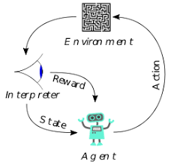
“Reinforcement Learning is a family of algorithms
and techniques used for Control (e.g. Robotics, Autonomous driving, etc..) and Decision making. These approaches solve problems that need to be expressed as a Markov Decision
Process (MDP).”
Notes:
Reinforcement learning (RL) is an area of machine learning concerned with how intelligent agents ought to take actions in an environment in order to maximize the notion of cumulative reward. Reinforcement learning is one of three basic machine learning paradigms, alongside supervised learning and unsupervised learning.

Slide 10
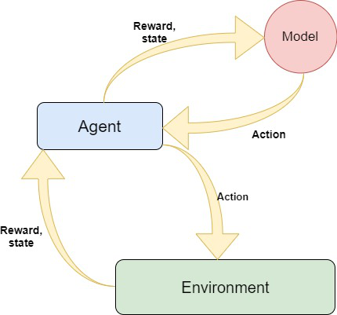
RL
The Environment
(the game that we just build)
The Model
(Reinforcement model for move prediction)
The Agent
(Intermediary between Environment and Model)
Notes:
the environment (our game)
and the agent
Model is pytorch model in deep learning

Slide 11

What does this mean?

Slide 12
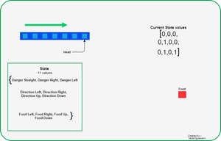
Reward:
-eat food : +10
-game over : -10
-else:0
Action :
[1,0,0]=>straight
[0,1,0]=>right turn
[0,0,1]=>left turn
Notes:
It means that we need to describe our game by a set of states S (for example, an index based on Snake’s position), a set of actions A (for example, Up, Down, Right, Left), a reward function R (for example, +10 when Snake eats an apple, -10 when Snakes hits a wall) and optionally a transition function T that describes the transitions among states. To use Reinforcement Learning, we need to formalize our problem using these 4 components.

Slide 13
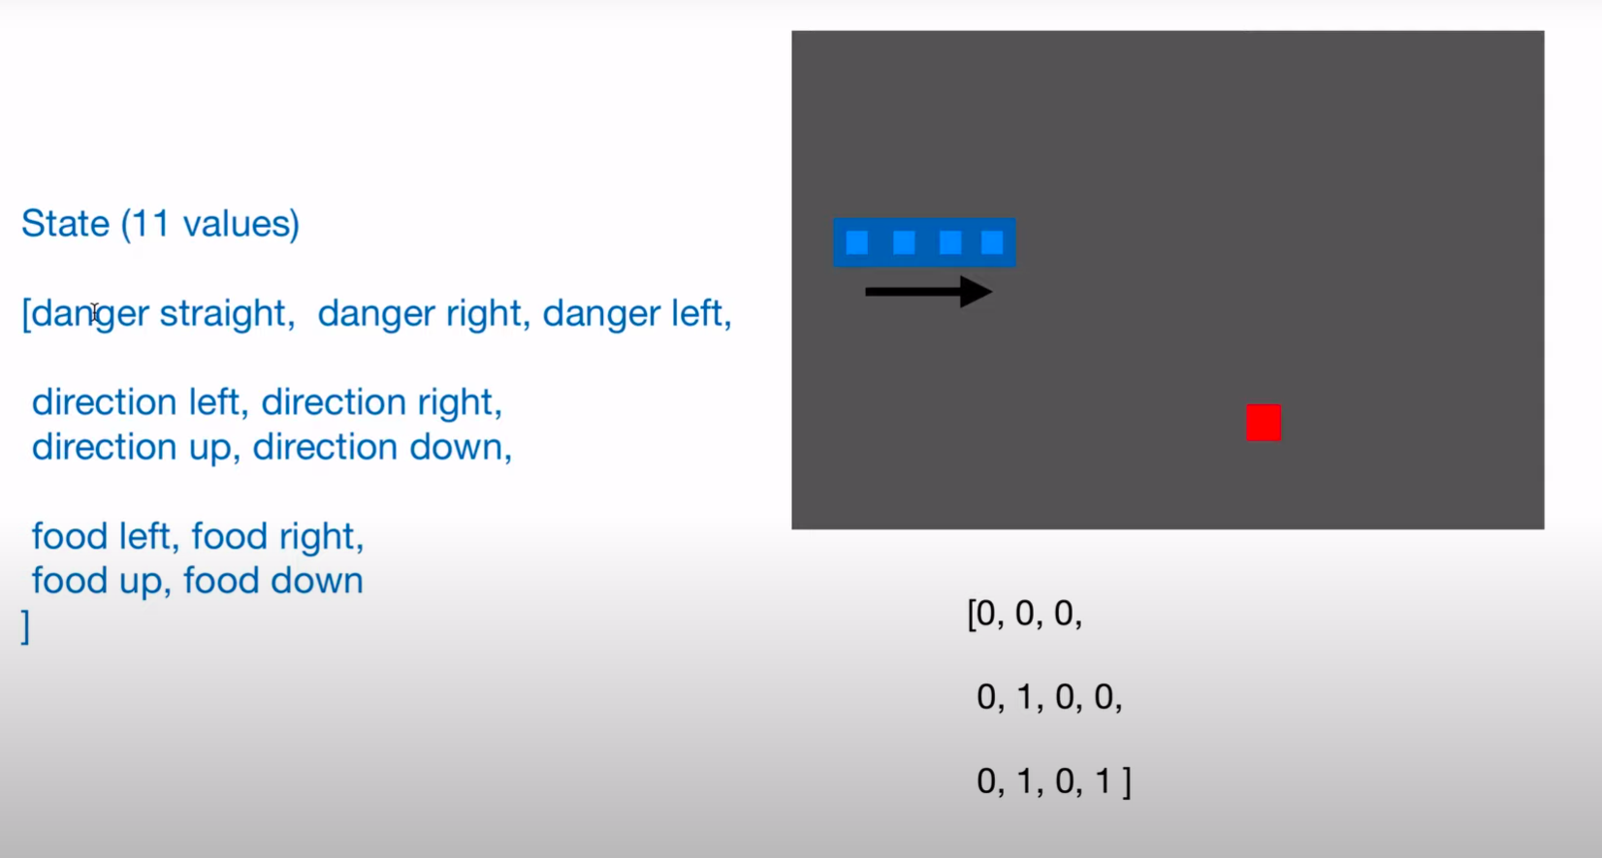
Notes:
Also The model is designed using Pytorch, but you can also use TensorFlow based on your comfort.
We are using Dense neural network with an input layer of size 11 and one dense layer with 256 neurons and output of 3 neurons. You can tweak these hyper parameters to get the best result.

Slide 14
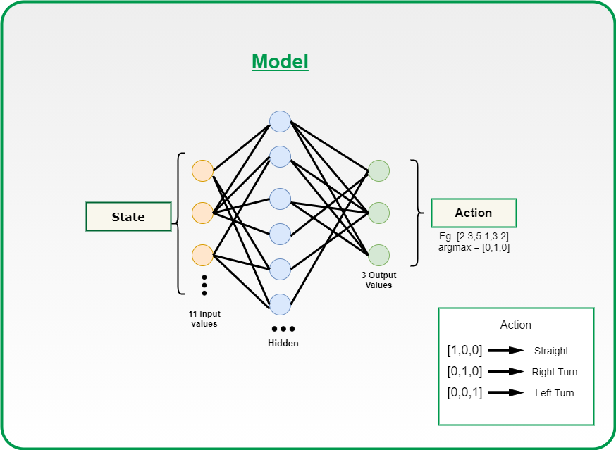
Notes:
The model is designed using Pytorch, but you can also use TensorFlow based on your comfort.
We are using Dense neural network with an input layer of size 11 and one dense layer with 256 neurons and output of 3 neurons. You can tweak these hyper parameters to get the best result.

Slide 15
04
Code logic
Notes:
In my implementation, I used Deep Q-Learning instead of a traditional supervised Machine Learning approach. What’s the difference? Traditional ML algorithms need to be trained with an input and a “correct answer” called target.

Slide 16
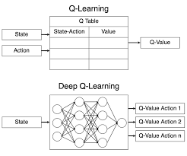
Notes:
In my implementation, I used Deep Q-Learning instead of a traditional supervised Machine Learning approach. What’s the difference? Traditional ML algorithms need to be trained with an input and a “correct answer” called target.
The system will then try to learn how to predict targets based on unseen inputs. In this example, we don’t know the best action to take at each state of the game (this is actually what we are trying to learn!), so a traditional approach would not be effective.

Slide 17
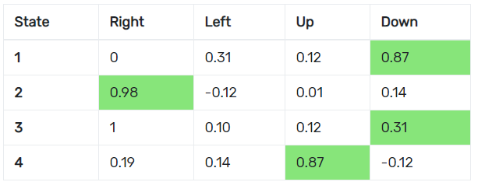
Q-Table
Notes:
To understand how the agent takes decisions, we need to know what a Q-Table is. A Q-table is a matrix that correlates the state of the agent with the possible actions that the agent can adopt. The values in the table are the action’s probability of success (technically, a measure of the expected cumulative reward), which were updated based on the rewards the agent received during training. An example of a greedy policy is a policy where the agent looks up the table and selects the action that leads to the highest score.
In the example, we might want to choose RIGHT if we are in State 2, and we might want to go UP if we are in State 4. The values in the Q-Table represent the cumulative expected reward of taking action a from a state s. In other words, these values give us an indication of the average reward that the agent obtains if it takes action a from that state s. This table is the policy of the agent that we mentioned before: it determines what actions should be taken from every state to maximize the expected reward. What’s the problem with this? The policy is a table, hence it can only handle a finite state space. In other words, we cannot have an infinitely large table with infinite states. This might be a problem for those situations where we have a very big number of possible states.

Slide 18
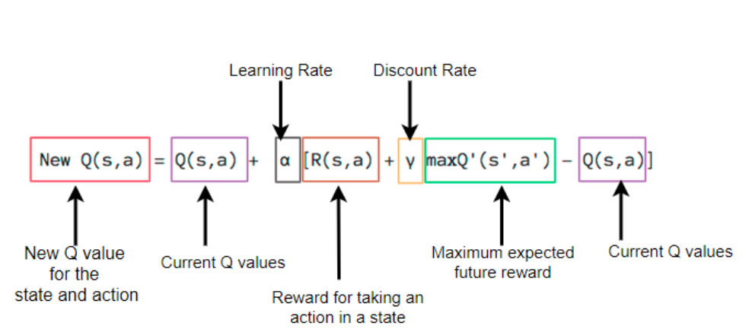
Bellman Equation
Notes:
Deep Q-Learning increases the potentiality of Q-Learning by converting the table into Deep Neural Network — that is a powerful representation of a parametrized function. The Q-values are updated according to the Bellman equation:

Slide 19
How algorithm works ?
Notes:
On a general level, the algorithm works as follow:
The game starts, and the Q-value is randomly initialized.
The agent collects the current state s (the observation).
The agent executes an action based on the collected state. The action can either be random or returned by its neural network. During the first phase of the training, the system often chooses random actions to maximize exploration. Later on, the system relies more and more on its neural network.
When the AI chooses and performs the action, the environment gives a reward to the agent. Then, the agent reaches the new state state’ and it updates its Q-value according to the Bellman equation as mentioned above. Also, for each move, it stores the original state, the action, the state reached after performed that action, the reward obtained and whether the game ended or not. This data is later sampled to train the neural network. This operation is called Replay Memory.
These last two operations are repeated until a certain condition is met (example: the game ends).

Slide 20
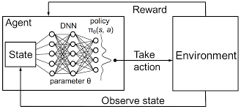
Notes:
On a general level, the algorithm works as follow:
The game starts, and the Q-value is randomly initialized.
The agent collects the current state s (the observation).
The agent executes an action based on the collected state. The action can either be random or returned by its neural network. During the first phase of the training, the system often chooses random actions to maximize exploration. Later on, the system relies more and more on its neural network.
When the AI chooses and performs the action, the environment gives a reward to the agent. Then, the agent reaches the new state state’ and it updates its Q-value according to the Bellman equation as mentioned above. Also, for each move, it stores the original state, the action, the state reached after performed that action, the reward obtained and whether the game ended or not. This data is later sampled to train the neural network. This operation is called Replay Memory.
These last two operations are repeated until a certain condition is met (example: the game ends).

Slide 21
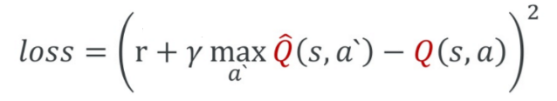
Loss
Notes:
The Deep neural network optimizes the output (action) to a specific input (state) trying to maximize the expected reward. The value that expresses how good the prediction is compared to the truth is given by the Loss function. The job of a neural network is to minimize the loss, to reduce the difference between the real target and the predicted one. In our case, the loss is expressed as:

Slide 22
30 games
Notes:
Q-learning is a reinforcement learning method that teaches a learning agent how to perform a task by rewarding good behavior and punishing bad behavior. In Snake, for example, moving closer to the food is good. Going off the screen is bad. At each point in the game, the agent will choose the action with the highest expected reward.

Slide 23
After 100 games
Notes:
Q-learning is a reinforcement learning method that teaches a learning agent how to perform a task by rewarding good behavior and punishing bad behavior. In Snake, for example, moving closer to the food is good. Going off the screen is bad. At each point in the game, the agent will choose the action with the highest expected reward.

Slide 24
Thanks!

